Slide 1
UNIT-V
Transistors

Slide 2
UNIT-V-Transistors: Syllabus
BJT Construction, Operation, Characteristics (CB, CE, CC Configuration) and uses- FET & MOSFET Construction, Operation, Characteristics (CS Configuration) and uses.

Slide 3
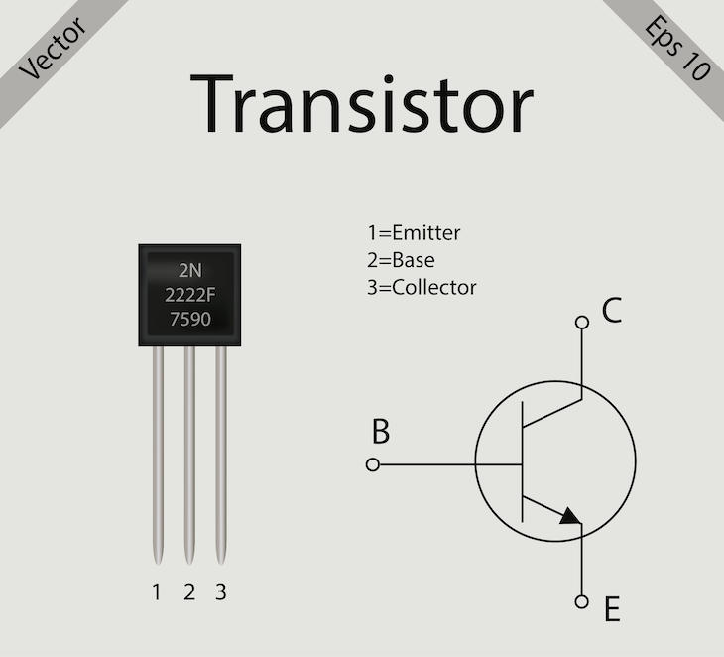
A transistor is a miniature semiconductor that regulates or controls current or voltage flow in addition amplifying and generating these electrical signals and acting as a switch/gate for them.
Typically, transistors consist of three layers, or terminals, of a semiconductor material, each of which can carry a current.

Slide 4
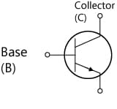
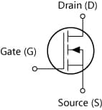
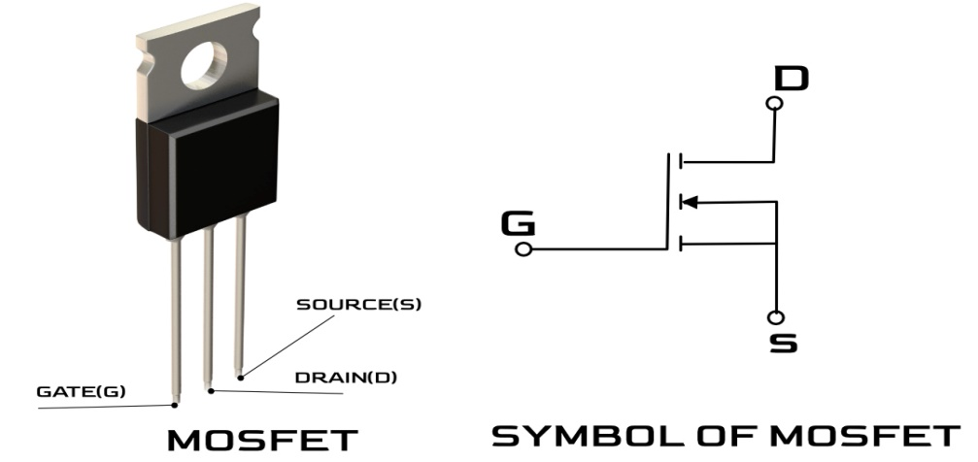
A transistor is a semiconductor device used to amplify or switch electronic signals. Transistors are broadly divided into three types: bipolar transistors (bipolar junction transistors: BJTs) and field-effect transistors (FETs),

Slide 5
BJT-Introduction
Bipolar Junction Transistor (BJT) is an active device. It works as a current-controlled current source.
It’s basic action is control of current at one terminal by
controlling current applied at other terminal. Current conduction is due to two types of charge carriers i.e due to both Holes and Electrons. (hence the name Bipolar)
It consists of Input junction and Output junction. It is a Bipolar junction transistor (BJT). Transistor means Transfer Resistor.
Signals transfer from Low resistance path to High Resistance path (Transfer resistor ).

Slide 6
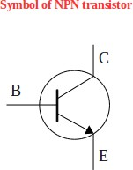
Transistor consists of three terminals they are
Emitter, Base, Collector.
Emitter is a heavily doped region,
Base is lightly doped region and
Collector is moderately doped region.
Transistors are divided into two types - They are
PNP and NPN transistors.
Arrow placed on the emitter of the transistor indicates the direction of current flow.
The direction of current flow is always from ‘p’ region to ‘n’ region.

Slide 7
Construction of Bipolar Junction Transistor
BJT is a semiconductor device that is constructed with 3 doped semiconductor Regions i.e. Base, Collector & Emitter separated by 2 p-n Junctions.
Bipolar transistors are manufactured in two types, PNP and NPN, and are available as separate components, usually in large quantities.
The prime use or function of this type of transistor is to amplify current. This makes them useful as switches or amplifiers.
They have a wide application in electronic devices like mobile phones, televisions, radio transmitters, and industrial control.

Slide 8
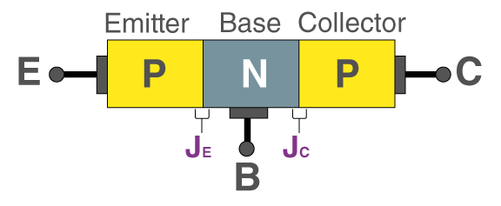
Types of Bipolar Junction Transistor(BJT)
There are two types of bipolar junction transistors:
PNP bipolar junction transistor
NPN bipolar junction transistor
In PNP BJT, the n-type semiconductor is sandwiched between the two p-type semiconductors. The two p-type semiconductors act as emitter and collector respectively while the n-type semiconductor acts as a base.
This PNP is shown in the figure below

Slide 9
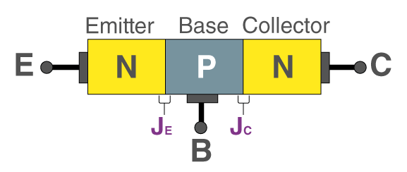
The current enters the transistor through the emitter such that the emitter-base junction is forward biased and the collector-base junction is reverse biased.
NPN BJT
In NPN BJT, p-type semiconductor is sandwiched between the two n-type semiconductors. The two n-type semiconductors act as emitter and collector respectively while the p-type semiconductor acts as a base. This is shown in the figure below.

Slide 10
Operation of Bipolar Junction Transistor
There are three operating regions of a bipolar junction transistor:
Active region: The region in which the transistors operate as an amplifier.
In the active region, a Bipolar Junction Transistor (BJT) operates as an amplifier, where it amplifies a small input signal by controlling a larger output current. The transistor acts as a linear element in this region, allowing for the amplification of signals without significant distortion.
I_{c}= β.I_{b}

Slide 11
Key Characteristics of the Active Region:
Forward Bias:
The base-emitter junction is forward biased, allowing for the flow of current from emitter to base.
Reverse Bias:
The collector-base junction is reverse biased, allowing for the flow of current from collector to base.
Linear Operation:
The Q-point (operating point) is chosen such that the transistor's behavior is linear, enabling amplification without distortion.
Amplification:
A small change in the base current or voltage results in a larger change in the collector current, thus amplifying the input signal.
Current Control:
The collector current is controlled by the base current, and it's relatively independent of the collector-emitter voltage in this region.

Slide 12
Saturation region: The region in which the transistor is fully on and operates as a switch such that collector current is equal to the saturation current. I_{c} = I(saturation)
In saturation, a BJT acts like a fully on switch, with both the base-emitter and base-collector junctions forward biased, allowing maximum current flow through the transistor with only a small voltage drop across the collector junction. The transistor essentially "locks" in the on state and doesn't respond well to changes in base current or voltage.
Switch Behavior: The BJT in saturation acts like a closed switch, allowing a large current to flow between the collector and emitter.
Applications: Saturation is used in applications where the transistor is intended to be fully on, like in a closed switch or when the transistor needs to deliver a large current.

Slide 13
Cut-off region: The region in which the transistor is fully off and collector current is equal to zero. I_{c} = 0.
In the cutoff region of a Bipolar Junction Transistor (BJT), the transistor is essentially "off." Both the base-emitter and base-collector junctions are reverse biased, preventing any significant current flow from the collector to the emitter. The BJT acts like an open switch in this mode.
Open Switch: Since there's no current flow, the BJT acts like an open switch, blocking any signal or current from passing through the collector-emitter path.
Application: The cutoff region is used for switching off the transistor in digital circuits and other applications where a transistor is needed to be in a "off" state.

Slide 14
Need of Configurations
In order to measure input and output voltages transistor has to work like a Two-port network.
Port means two terminals. For a two-port network we require four terminals, but transistor has three terminals.
By making one of the transistor terminal as common, three different configurations are made.
They are
Common Base configuration
Common Emitter configuration
Common Collector configuration.

Slide 15
Types of Configuration
Name of the configuration | Common Terminal | Input Terminal | Output Terminal
Common Emitter | Emitter | Base | Collector
Common Base | Base | Emitter | Collector
Common Collector | Collector | Base | Emitter
Note: Base is always input terminal except in Common Base configuration. Collector is always output terminal except in Common Collector configuration.

Slide 16
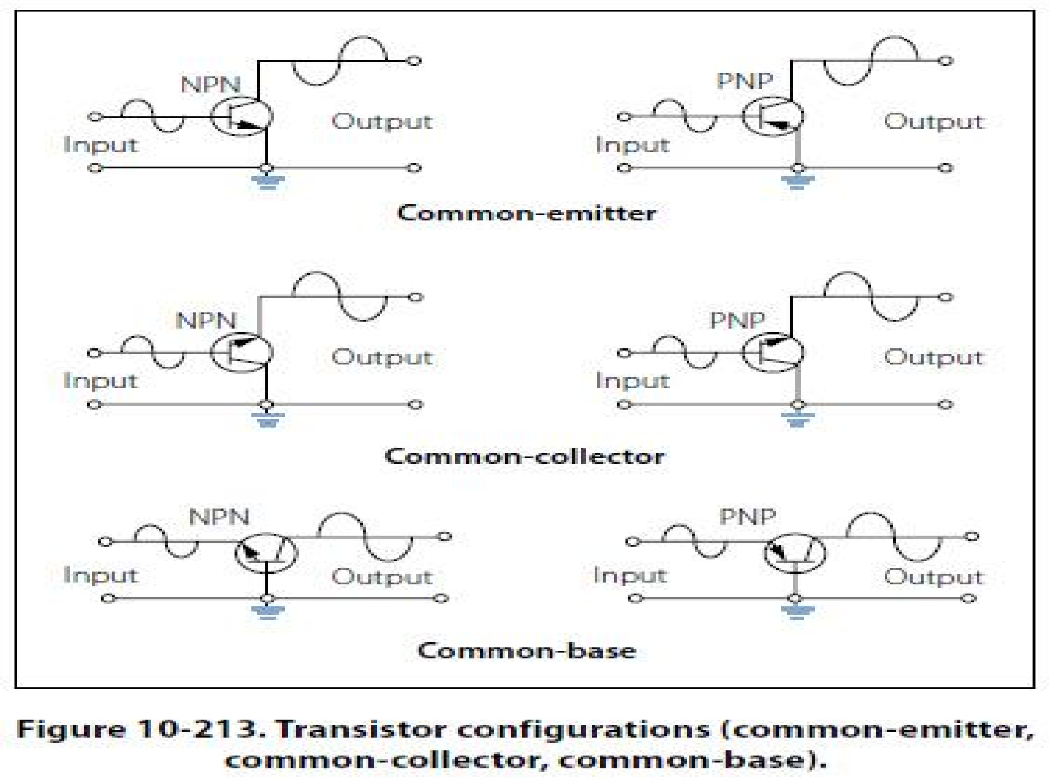

Slide 17
Transistor Construction
In an NPN transistor, a layer of P-type material is sandwiched between two layers of N-type material.
The BJT consists of a silicon (or germanium) crystal in which a thin layer of N-type silicon is sandwiched between two layers of P-type silicon which forms PNP transistor.
The emitter is heavily doped so that it can inject a large number of charge carriers into the base.
The base is lightly doped and very thin. It passes most of the injected charge carriers from the emitter into the collector.
The collector is moderately doped.

Slide 18
Transistor characteristics
 | Input characteristics |  |  |  | Output characteristics
Name of the configur ation | Input Voltage X-axis | Input Current Y-axis | Output voltage Constant |  | Output Voltage X-axis | Output Current Y-axis | Input Current Constant
CE | ^{V}BE | I_{B} | ^{V}CE |  | ^{V}CE | I_{C} | I_{B}
CB | ^{V}EB | I_{E} | ^{V}CB |  | ^{V}BC | I_{C} | I_{E}
CC | ^{V}BC | I_{B} | ^{V}EC |  | ^{V}CE | I_{E} | I_{B}

Slide 19
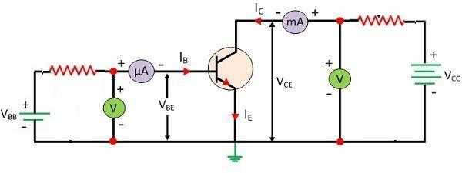
CE - Configuration
In a Common-Emitter (CE) configuration of a Bipolar Junction Transistor (BJT), the emitter terminal is connected to both the input and output circuits, making it the common terminal.
The input signal is applied between the base and emitter, while the output is taken from the collector and emitter.
This configuration is widely used in transistor-based amplifiers due to its high current and power gain.

Slide 20
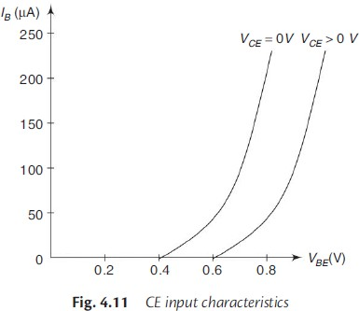
CE – Input Characteristics
Input Characteristics:
The collector-to-emitter voltage is kept constant at zero volt, and the base current I_{B} is increased from zero in equal steps by increasing V_{BE}.
The value of V_{BE} is noted for each setting of I_{B}.
This procedure is repeated for higher fixed values of V_{CE},
This curve shows the relationship between input voltage (V_{BE}) to input current (I_{B}) for various levels of output voltage (V_{CE}).

Slide 21
When V_{CE} = 0, the emitter-base junction is forward biased and behaves as a forward biased diode. Hence, the input characteristic for V_{CE} = 0 is similar to that of a forward-biased diode.
When V_{CE} is increased, the width of the depletion region at the reverse-biased collector-base junction will increase. Hence, the effective width of the base will decrease.
This effect causes a decrease in the base current I_{B}. Hence, to get the same value of I_{B} as that for V_{CE} = 0, V_{BE} should be increased. Therefore, the curve shifts to the right as V_{CE} increases.
Reciprocal of the slope of the curve is Input Resistance and it is medium. Input Resistance is about 750 Ohms.
R_{in}=∆ V_{BE} / ∆ I_{B} .

Slide 22
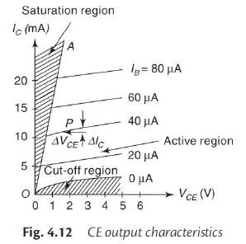
CE – Output Characteristics
The base current I_{B} is kept constant at a suitable value by adjusting the base-emitter voltage, V_{BE}.
The magnitude of the collector-emitter voltage V_{CE} is increased in suitable equal steps from zero and the collector current I_{C} is noted for each setting V_{CE}. This is repeated for different fixed values of I_{B}.
This curve shows the relationship between output voltage (V_{CE}) to output current (I_{C}) for various levels of input current (I_{B}).

Slide 23

When I_{B} is kept constant,
As V_{CE} increases, V_{CB} also increases,
We can write
As V_{CB} increases, depletion region of Base Collector junction increases, effective Base width decreases, I_{B} decreases.
As V_{CE} increases, I_{C} increases, We have I_{C} = β I_{B}
I_{C} not only depends on I_{B} but also V_{CE}
_{We have}
^{V}CE ^{= V}CB ^{+ V}BE

Slide 24
For larger values of V_{CE}, due to early effect, a very small change in α is reflected in a very large change in β.
For example, when α = 0.98, β =
0.98
= 49.
1−0.98
If α increases to 0.985, then β =
Here, a slight increase in α by about 0.5% results in an increase in β by about 34%.
Hence, the output characteristics of CE configuration show a larger slope when compared with CB configuration.
0.985
= 66.
1−0.985
In active region of CE configuration transistor will work as an Amplifier. Here Input junction is forward biased and Collector Base junction is Reverse biased.
Transistor output current I_{C} responds to the input current I_{B}. I_{C} varies with changes in V_{CE} when I_{B} is kept constant. If V_{CE} is increased continuously then depletion region in CB junction increases. It increases I_{C} Rapidly and operates the transistor in the active Region.

Slide 25
In Cut-off region of CE configuration both Emitter Base junction and Collector Base junction are reverse biased.
It is the region below the curve I_{B} = 0.
Current is due to minority charge carriers, called as Reverse saturation current.
The transistor is virtually an open circuit between collector and emitter.
In Saturation region of CE configuration both junctions are forward biased.
Current is maximum.
An increase in the base current I_{B} does not cause a corresponding large change in I_{C}.
In saturation region, current I_{C} = V_{CC} / R_{L.}

Slide 26
Output Resistance: R_{out}=∆ V_{CE} / ∆ I_{C} .
Reciprocal of the slope of the curve is output Resistance and it is medium.
Output Resistance is about 45 Kilo Ohms.
Conclusion:
It has medium Input Resistance and medium Output Resistance. Hence CE configuration is preferred for Amplification purpose.
Application: CE configuration is used for Amplification
purpose.

Slide 27
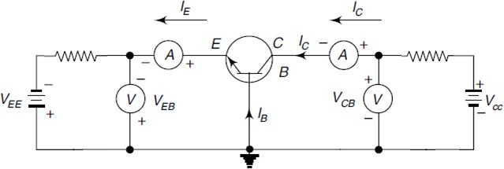
CB configuration
Base is common ,
Emitter is input terminal and
Collector is output terminal.
Emitter base junction (I/P) Junction is forward biased.
Collector base Junction (O/P) junction is reverse biased.

Slide 28
CB - Input characteristics
Input characteristics:
Input characteristics represents forward characteristics of emitter base diode for various collector voltages V_{CB} as constant.
The collector base voltage V_{CB} is kept constant at zero volt and the emitter current I_{E} is increased from zero in suitable equal steps by increasing V_{EB}.
This is repeated for higher fixed values of V_{CB}
A curve is drawn between I_{E} and V_{EB} at constant V_{CB}.

Slide 29
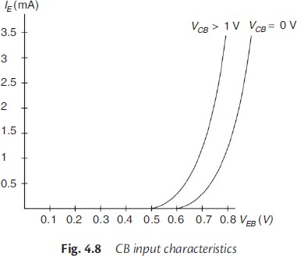
CB - Input characteristics
When V_{CB} = 0 and the emitter base junction is forward biased, the junction behaves as a forward biased diode so that emitter current I_{E} increases rapidly with small increase in V_{EB}.
When V_{CB} is increased keeping V_{EB} constant, the width of the base region
will decrease.
This effect results in an increase of I_{E}. (as Rate of recombination ↓ & I_{B} is reduced)
Therefore, the curves shift towards the left as V_{CB} is increased.
This curve shows the relationship between input voltage (V_{BE}) to input current (I_{E}) for various levels of output voltage (V_{CB}).

Slide 30
CB - Input characteristics
Input Resistance:
∆𝑉_{𝐵𝐸}
𝑅_{𝑖} =
𝑂ℎ𝑚𝑠
∆𝐼
𝐸
Input Resistance is the reciprocal of the slope of the characteristic curve.
Input Resistance is Low in Common Base configuration.

Slide 31
CB - Output characteristics
To determine the output characteristics, the emitter current I_{E} is kept constant at a suitable value by adjusting the emitter- base voltage V_{EB}.
Then V_{CB} is increased in suitable equal steps and the collector current I_{C} is noted for each value of I_{E}. This is repeated for different fixed values of I_{E}.
The curves of V_{CB} vs I_{C} are plotted for constant values of I_{E}.

Slide 32
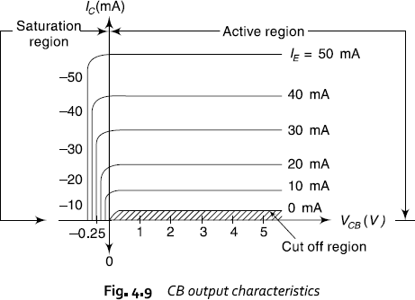
CB - Output characteristics
From the characteristics, it is seen that for a constant value of I_{E}, I_{C} is independent of V_{CB} and the curves are parallel to the axis of V_{CB}.
and IC ≅ 𝐼_{𝐸}
Also, I_{C} flows even when V_{CB} is equal to zero.
This curve shows the relationship between output voltage (V_{CB}) to output current (I_{C}) for various levels of input current (I_{E}).

Slide 33
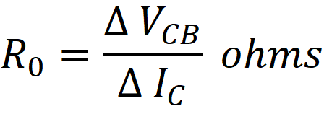
CB - Output characteristics
As the emitter-base junction is forward biased, the majority carriers, i.e. electrons, from the emitter are injected into the base region.
Due to the action of the internal potential barrier at the reverse biased collector-base junction, they flow to the collector region and give rise to I_{C} even when V_{CB} is equal to zero.
Output Resistance:
Reciprocal of the slope of the characteristics gives the output resistance.
Output Resistance is Very High. Typical Value is around 500Kilo ohms.

Slide 34
Output characteristics
There are three different regions in transistor Output characteristics.
Saturation Region
Active Region
Break Down Region.

Slide 35
CB - Output characteristics
Saturation Region: In this region both I/P and O/P Junctions are forward biased.
A small Change in V_{CB} results a large change in I_{C.}
Active region: In active region I/P Junction is forward biased and O/P is reverse biased.
In this region collector current I_{C} is independent of collector
voltage V_{CB} and Depends only on emitter current.
Cut-off Region: In this both I/P & O/P Junctions are reverse biased.
The Region below I_{E} = 0 is cutoff region.

Slide 36
CB- Conclusions
Input Resistance of CB configuration is very Low.
Output Resistance of CB Configuration is very High.
Current Gain is less than unity.
It is used for high frequency circuits.
In CB configuration current gain varies between 0.9 to 0.985(α).

Slide 37
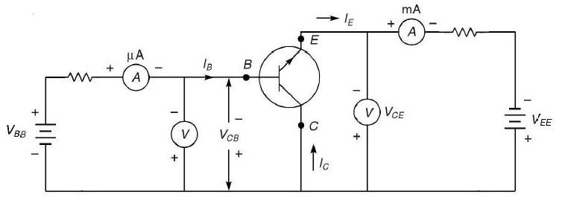
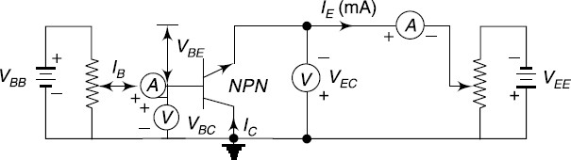
CC - Configuration
Collector is common,
Base is input terminal and
Emitter is output terminal.

Slide 38
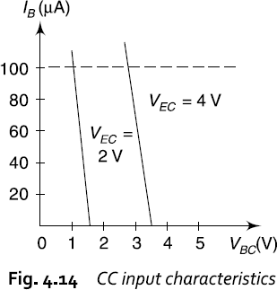
CC – Input Characteristics
Input Characteristics: To determine the input characteristics, V_{EC} is kept at a suitable fixed value.
The base-collector voltage V_{BC} is increased in equal steps and
the corresponding increase in I_{B} is noted.
This is repeated for different fixed values of V_{EC}.
This curve shows the relationship between input voltage (V_{BC}) to input current (I_{B}) for various levels of output voltage (V_{EC}).

Slide 39
CC – Input Characteristics
In Common Collector, Input voltage V_{CB} is largely determined by output voltage V_{CE}.
Since
We can write,
When V_{CB} increases, at constant V_{CE},
•
^{V}CE ^{= V}CB ^{+ V}BE
^{V}BE ^{= V}CE ^{- V}CB
V_{BE} decreases and hence I_{B} decreases.

Slide 40
CC – Input Characteristics
Input Resistance: R_{in}=∆ V_{CB} / ∆ I_{B} .
Reciprocal of the slope of the curve is input resistance and it is very high about 750 Kilo ohms.

Slide 41
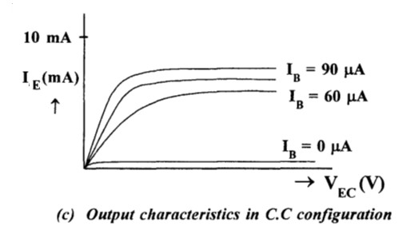
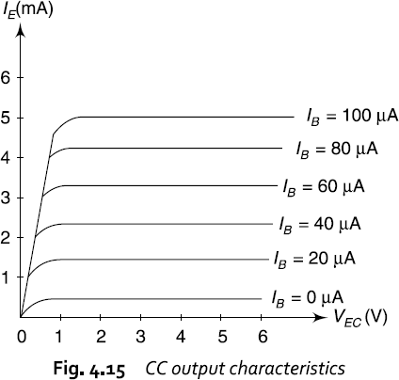
CC – Output Characteristics
Output Characteristics:
The base current I_{B} is kept constant at a suitable value by adjusting the base-collector voltage, V_{CE}.
The magnitude of the collector-emitter voltage V_{CE} is increased in suitable equal steps from zero and the collector current I_{E} is noted for each setting V_{EC}.
This is repeated for different fixed values of I_{B}.
This curve shows the relationship between output voltage (V_{EC}) to output current (I_{E}) for various levels of input current (I_{B}).

Slide 42
CC – Output Characteristics
For all practical purposes, the output characteristics of the CC configuration are the same as for the CE configuration.
The input current, I_{B}, is the same for both the CE and CC
characteristics.
I_{C} of the CE characteristics is replaced by I_{E} for the CC characteristics (since α ≈ 1).
Output Resistance: R_{out}=∆ V_{CE} / ∆ I_{E}
Reciprocal of the slope of the curve is output Resistance
Output Resistance is very low of the order of 25 ohms.

Slide 43
CC – Output Characteristics
Application : It can be used as a buffer amplifier.
Also called Emitter-Follower (EF).
The CC configuration is used primarily for impedance- matching purposes since it has a high input impedance and low output impedance, opposite to that of the CB and CE configurations.

Slide 44
Comparison of CB,CE and CC Configurations
Property | Common Base configuration | Common Emitter configuration | Common Collector configuration
Input Resistance | Low (Around 100Ω) | Medium (Around 750 Ω) | High (750 kilo Ω )
Output Resistance | High | Medium | Very low
Current Gain | <1 | High | High
Voltage Gain | Around 150 | Around 500 | <1
Phase shift between input and output | No phase shift | 180⁰ | 0⁰ or 360⁰ No phase shift
Applications | For high frequency circuits | For Audio amplification | For impedance matching

Slide 45
FET Contents
Construction & Working of JFET,
JFET characteristics,
FET Parameters,
Construction & Working of MOSFET,
MOSFET characteristics (Enhancement and depletion mode)
Comparison of JFET & MOSFET
Biasing of JFET - Self bias and fixed bias.
Small signal Analysis of
Common Source,
Common Drain and
Common Gate amplifier configurations

Slide 46
Field Effect Transistor
A Field-Effect Transistor (FET) is a three-terminal semiconductor device that controls the flow of current between two terminals (source and drain) by applying a voltage to the third terminal (gate).
This voltage-controlled device utilizes an electric field to modulate the conductivity of the channel between the source and drain, unlike bipolar junction transistors which are current-controlled.
FETs are widely used in various applications, including amplifiers, switches, and in integrated circuits.
Field-Effect”– Electric field controls the conduction path of Output circuit, hence the name Field Effect Transistor.

Slide 47
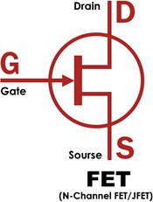
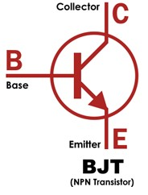
FET
Field Effec Transistor
Terminals
BJT
Bipolar Junction Transistor
Terminals
Unipolar Device, Conduction is due to either Electrons or Holes
Voltage controlled Device (n channel & p-channel).
Very High Input Impedance and Easy to fabricate
More Stable to Temperature changes compared to BJT.
Negative Temperature coefficient Gain Bandwidth product is less compared to BJT
Costlier
Bipolar Device, Conduction is due to Both Electrons and Holes
Current controlled Device (npn & pnp)
Very Low Input Impedance
Complicate to fabricate
Less Stable to Temperature
changes compared to FET
Positive Temperature coefficient
Gain Bandwidth product is
more compared to FET
Cheaper

Slide 48
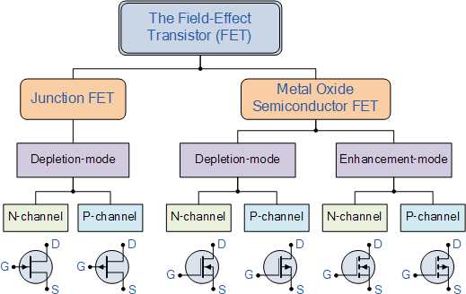
FET

Slide 49
Types:
There are several types of FETs, including:
Junction Field-Effect Transistor (JFET): Uses a reverse-biased p-n junction to control the channel width and thus the current.
Metal-Oxide-Semiconductor Field-Effect Transistor (MOSFET): Uses an insulator (typically an oxide) between the gate and the channel, providing a high level of insulation.
N-channel and P-channel FETs:
FETs can be either N-channel or P-channel, depending on the type of charge carrier that conducts current in the channel.

Slide 50
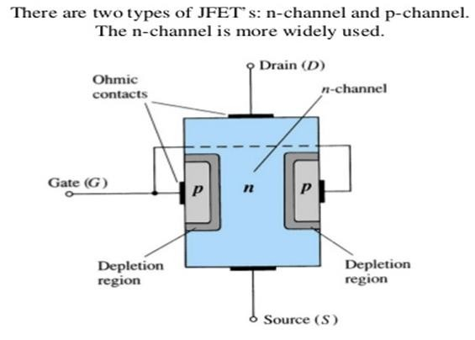
JFET Construction and Operation
It consists of an N-type bar which is made of silicon. Ohmic contacts (terminals), made at the two ends of the bar, are called source and drain.
Source (S): This terminal is connected to the negative pole of the battery. Electrons which are the majority carriers in the N-type bar enter the bar through this terminal.
Drain (D): This terminal is connected to the positive pole of the
battery. The majority carriers leave the bar through this terminal.
Gate (G): Heavily doped P-type silicon is diffused on both sides of the N-type silicon bar by which PN junctions are formed. These layers are joined together and called the gate G.

Slide 51
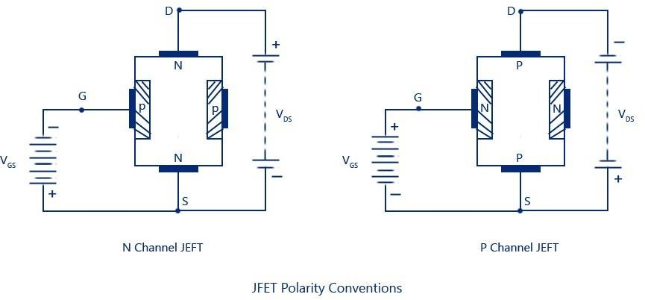
Channel: The region of the N-type bar between the depletion region is called the channel.
Majority carriers move from the source to drain when a potential difference V_{DS} is applied between the source and drain.
Conventional current at Source is denoted as I_{S}
Conventional current at Drain is denoted as I_{D}
Conventional current at Gate is denoted as I_{G}

Slide 52
N-channel and P-channel JFETs are two types of junction field-effect transistors (JFETs) that differ in the type of charge carriers they use to conduct current. N-channel JFETs use electrons, while P-channel JFETs use holes.
The principle of operation is similar for both, but the direction of current flow and the polarity of gate voltages are reversed.
N-channel JFET: Charge Carriers: Electrons, Channel Material: N-type semiconductor, Gate Material: P-type semiconductor, forming a p-n junction with the N-type channel.
Operation: A positive drain voltage is applied to the drain terminal with respect to the source. A negative voltage is applied to the gate terminal to reduce the width of the channel and control the drain current.
P-channel JFET:
Charge Carriers: Holes.
Channel Material: P-type semiconductor.
Gate Material: N-type semiconductor, forming a p-n junction with the P-type channel.
Operation: A negative drain voltage is applied to the drain terminal with respect to the source. A positive voltage is applied to the gate terminal to reduce the width of the channel and control the drain current.

Slide 53
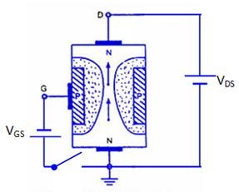
JFET-Working
In a reverse-biased p-n junction, The current carriers have diffused across the junction, leaving only uncovered positive ions on the n side and negative ions on the p side and forms a Electric Field.
As the reverse bias across the junction increases, the thickness of the region of immobile uncovered charges also increases.
The conductivity of this region is nominally zero because of
the unavailability of current carriers.
Hence we see that the effective width of the channel will become progressively decreased with increase in reverse bias.

Slide 54
Accordingly, for a fixed V_{DS}, the I_{D} will be a function of the reverse-biasing voltage across the gate junction.
The term field effect is used to describe this device because the mechanism of current control is due to the increasing reverse bias, i.e. the field associated with the region of uncovered charges.
Operating Conditions:
When V_{GS} = 0 and V_{DS} = 0
When V_{GS} is Decreased from Zero and V_{DS} = 0
When V_{GS} = 0 and V_{DS} is Increased from Zero
When V_{GS} is Negative and V_{DS} is Increased

Slide 55
1. When V_{GS} = 0 and V_{DS} = 0
When no voltage is applied between drain and source, and gate and source, the thickness of the depletion regions around the PN junction is uniform.
2. When V_{GS} is Decreased from Zero and V_{DS} = 0
In this case, the PN junctions are reverse biased and, hence, the thickness of the depletion region increases.
As V_{GS} is decreased from zero, the reverse-bias voltage across the PN junction is increased and, hence, the thickness of the depletion region in the channel also increases until the two depletion regions make contact with each other. In this condition, the channel is said to be cut-off.
The value of V_{GS} which is required to cut off the channel is called the cut off voltage V_{C}.

Slide 56
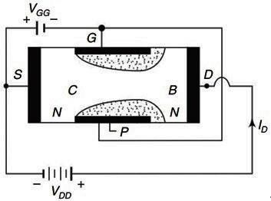
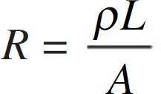
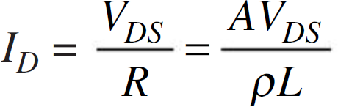
3. When V_{GS} = 0 and V_{DS} is Increased from Zero
Drain is positive with respect to the source with V_{GS} = 0. Now the majority carriers (electrons) flow through the N-channel from source to drain.
Therefore, the conventional current I_{D} flows from drain to source.
The magnitude of the current will depend upon
conductivity of the channel.
length (L) of the channel
cross-sectional area (A) of the channel at B
The magnitude of the applied voltage V_{DS}
𝜌 is the resistivity

Slide 57
4. When V_{GS} is Negative and V_{DS} is Increased
When the gate is maintained at a negative voltage less than the negative cut-off voltage, the reverse voltage across the junction is further increased.
Hence, for a negative value of V_{GS}, the curve of I_{D} versus V_{DS} is similar to that for V_{GS} = 0, but the values of V_{P} and Breakdown Voltage are lower.
The drain current I_{D} is controlled by the electric field that extends into the channel due to reverse-biased voltage applied to the gate; hence, this device has been given the name Field Effect Transistor.

Slide 58
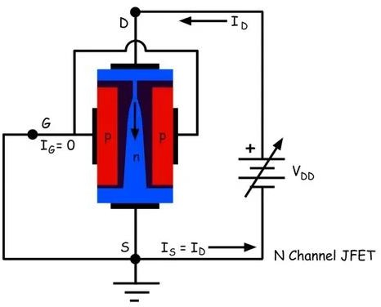
5. When V_{GS} = 0 and V_{DS} is Increased from Zero
As V_{DS} is increased, the cross-sectional area of the channel will be reduced.
At a certain value V_{P} of V_{DS}, the cross-sectional area at B becomes minimum. At this voltage, the channel is said to be pinched off and the drain voltage V_{P} is called the pinch-off voltage. Above the pinch-off voltage, at a constant value of V_{DS}, I_{D} increases with an increase of V_{GS}. Hence, a JFET is suitable for use as a voltage amplifier,

Slide 59
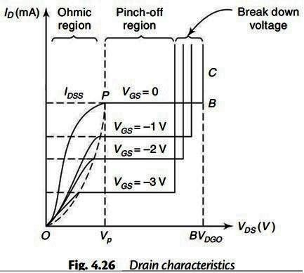
JFET characteristics
Curves that explains the relationship between voltage and current are characteristic curves.
FET characteristics are of two types
Drain characteristics or Static characteristics
Transfer characteristics

Slide 60
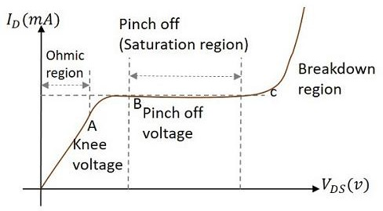
JFET - Drain Characteristics

Slide 61
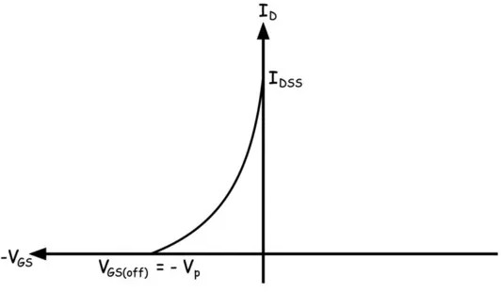
JFET – Transfer Characteristics
These curves establishes a relationship between I_{D} and V_{GS} keeping V_{DS} as constant. When V_{GS} = 0, Drain current is maximum and is equal to I_{DSS.} As V_{GS} is increased channel width Reduces and drain current I_{D} reduces. At one Particular Gate voltage, Channel is pinched off. The maximum reverse gate voltage where the channel is
pinched off is known as pinch off voltage.
In transfer characteristic, V_{DS} is maintained as constant at a suitable value greater than the Reference Voltage.
Gate voltage is increased till I_{D} is reduced to Zero.
The shape of the transfer characteristic is half parabola.

Slide 62
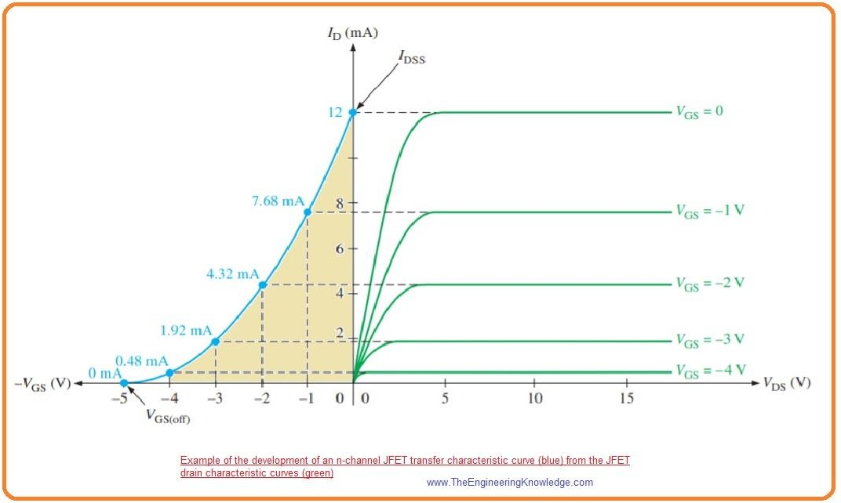
JFET – Characteristics
JFET – Transfer Characteristics
JFET – Drain Characteristics

Slide 63
MOSFET
Metal Oxide Semiconductor Field Effect Transistor
MOSFET’s operate the same as JFET’s but have a gate terminal that is electrically isolated from the conductive channel.
Field Effect Transistor whose Gate input is electrically insulated from the main current carrying channel and is therefore called an Insulated Gate Field Effect Transistor (IGFET).
It has a “Metal Oxide” Gate electrode which is electrically insulated from the main semiconductor n-channel or p-channel by a very thin layer of insulating material usually silicon dioxide, commonly known as glass.
Principle: By applying a transverse electric field across an insulator deposited on the semiconducting material, the thickness and, hence, the resistance of a conducting channel of a semiconducting material can be controlled.

Slide 64
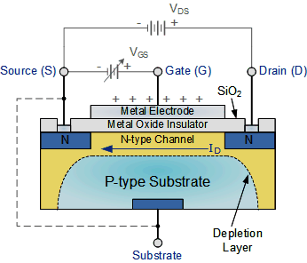
In a depletion MOSFET, the controlling electric field reduces the number of majority carriers available for conduction,
In enhancement MOSFET, application of electric field causes an increase in the majority carrier density in the conducting regions of the transistor.
Metal-Oxide-Semiconductor FET or another name Insulated- Gate FET (IGFET) : i) Metal: for the drain, source and gate connections to the proper surface- in particular the gate terminal and the control to be offered by the surface area of the contact. II) Oxide: Silicon dioxide insulating layer. III) Semiconductor: the basic structure on which the n- and p-typE regions are diffused.

Slide 65
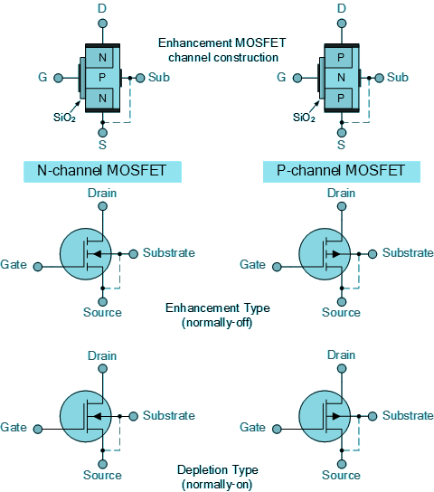
MOSFET
MOSFETs are available in two basic forms:
Depletion Type – the transistor requires V_{GS} to switch the device “OFF”.
The depletion mode MOSFET is equivalent to a “Normally Closed” switch.
Enhancement Type – the transistor requires V_{GS} to switch the device “ON”.
The enhancement mode MOSFET is equivalent to a “Normally Open” switch.

Slide 66
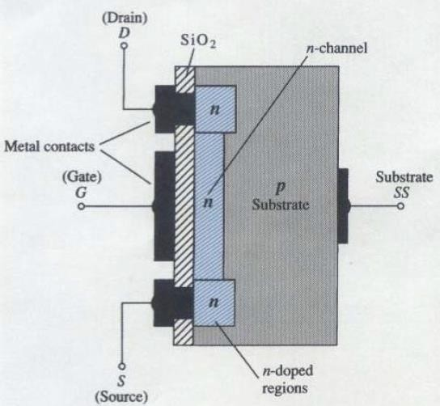
Depletion - MOSFET
A slab of p-type material is formed from a silicon base and is referred to as the substrate.
It is the foundation upon which the device will be constructed.
In some cases the substrate is internally connected to the source terminal.
However, many discrete devices provide an additional terminal labeled SS, resulting in a four-terminal device.
The source and drain terminals are connected through metallic contacts to n-doped regions linked by an n-channel.

Slide 67
The gate is also connected to a metal contact surface but remains insulated from the n- channel by a very thin silicon dioxide (SiO₂) layer.
SiO₂ is a insulator:
(i) Therefore, there is no direct electrical connection between the gate Terminal and the channel of a MOSFET.
(ii) Therefore, it construct very high input impedance of the device. Then it support the fact that the gate current (I_{G}) is essentially zero amperes for dc-biased configuration.
Basic Operation and Characteristics
The gate-to-source voltage V_{GS} is set to zero volts by the direct connection from one terminal to the other and a voltage V_{DS} is applied across the drain-to-source terminals.
The results is an attraction for the positive potential at the drain by the free electrons of the n-channel and a current similar to that established through the channel of the JFET.
In fact, the resulting current with V_{GS} = 0V continues to be labeled I_{DSS}.

Slide 68
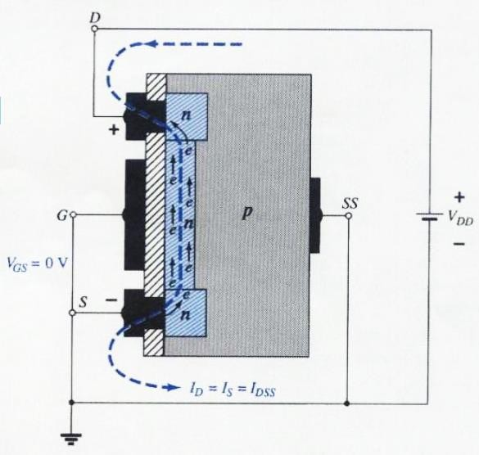
When V_{GS} is made negative. The negative potential at the gate will tend to pressure electrons toward the p-type substrate (like charges repel) and attract holes from the p- type substrate (opposite charge attract).
Depending on the negative bias established by V_{GS}, a level of recombination between electrons and holes will occur that will reduce the number of free electrons in the n-channel available for conduction.
The more negative bias, the higher rate of recombination. The resulting level of drain current is therefore reduced with increasing negative bias for V_{GS}.

Slide 69
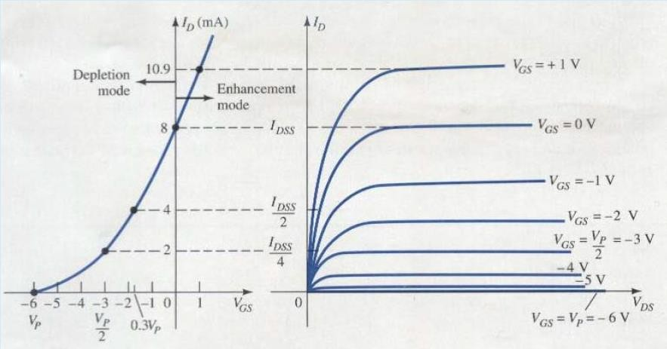
Depletion MOSFET - Characteristics
For positive values of V_{GS}, the positive gate will draw additional electrons (free carriers) from the p-type substrate and establish new carriers through the collisions resulting acceleration between particles.
As the gate-to-source voltage, V_{GS} continues to increase in the positive direction leads the drain current to increase at a rapid rate.

Slide 70
The vertical spacing between the V_{GS} = 0V and V_{GS} = +1V curves is a clear indication of how much the current has increased for the 1 V change in V_{GS}.
The application of a positive gate-to-source voltage has “enhanced” the level of free carriers in the channel compared to that encountered with V_{GS} =0V.
For this reason, the region of positive gate voltages on the drain or transfer characteristics is often referred to as the “enhancement region”, with the region between cut-off and the saturation level of I_{DSS} referred to as the “depletion region”.

Slide 71
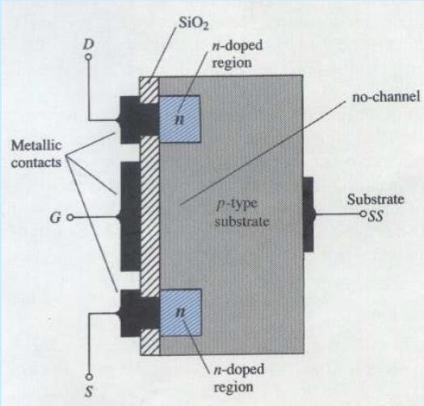
Enhancement - MOSFET
A slab of p-type material is formed from a silicon base and is referred to as substrate. Note here the absence of a channel between the two n-doped regions. This is the primary difference between the construction of depletion type and enhancement type MOSFETs.

Slide 72
(i) V_{GS} = 0 V and a voltage applied between the drain and source of the device, V_{DS} will result in a current of effectively zero amperes.With V_{DS} some positive voltage, V_{GS} =0V and terminal SS directly connected to the source, there are in fact two reverse biased p-n junctions between the n-doped regions and the p-substrate to oppose any significant flow between the drain and source.
(ii) Both V_{DS} and V_{GS} have been set at some positive voltage greater than 0V, establishing the drain and gate at a positive potential with respect to the source.
The positive potential at the gate will pressure the holes in the p- substrate along the edge of the SiO₂ layer to leave the area and enter deeper regions of the p- substrate. The result is a depletion region near the SiO₂ insulating layer void of holes.
However, the electrons in the p-substrate (the minority carriers) will be attracted to the positive gate and accumulate in the region near the surface of the SiO₂ layer. The SiO₂ layer and its insulating qualities will prevent the negative carriers from being absorbed at the gate terminal.

Slide 73
As V_{GS} increases in magnitude, the concentration of electrons near the SiO₂ surface increases until eventually the induced n-type region can support a measurable flow between drain and source.
The level of V_{GS} that results in the significant increase in drain current is called the threshold voltage ,V_{T}.
Since the channel is nonexistent with V_{GS} = 0V and “enhanced” by the application of a positive V_{GS} voltage, this type of MOSFET is called an enhancement-type MOSFET.
As V_{GS} is increased beyond the threshold level the density of free carriers in the induced channel will increase, resulting in an increased level of drain current.
However, if we hold V_{GS} constant and increase the level of V_{DS}, the drain current will eventually reach a saturation level as occurred for the JFET and depletion type MOSFET.

Slide 74
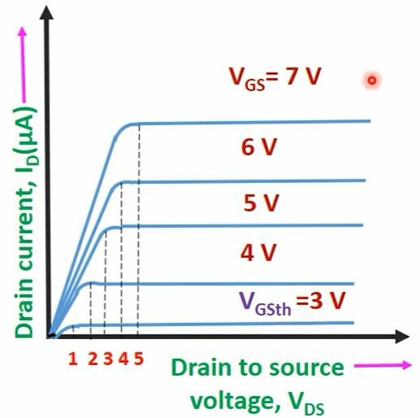
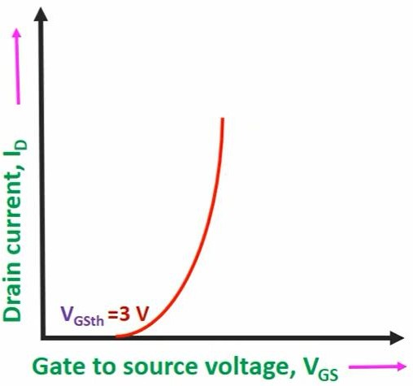
Enhancement – MOSFET characteristics
Darin Characteristics
Transfer Characteristics

Slide 75
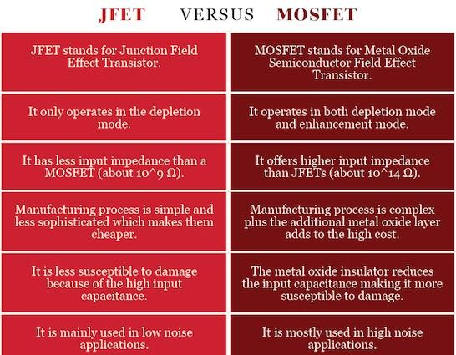

Slide 76
THANK YOU

